Slide 1
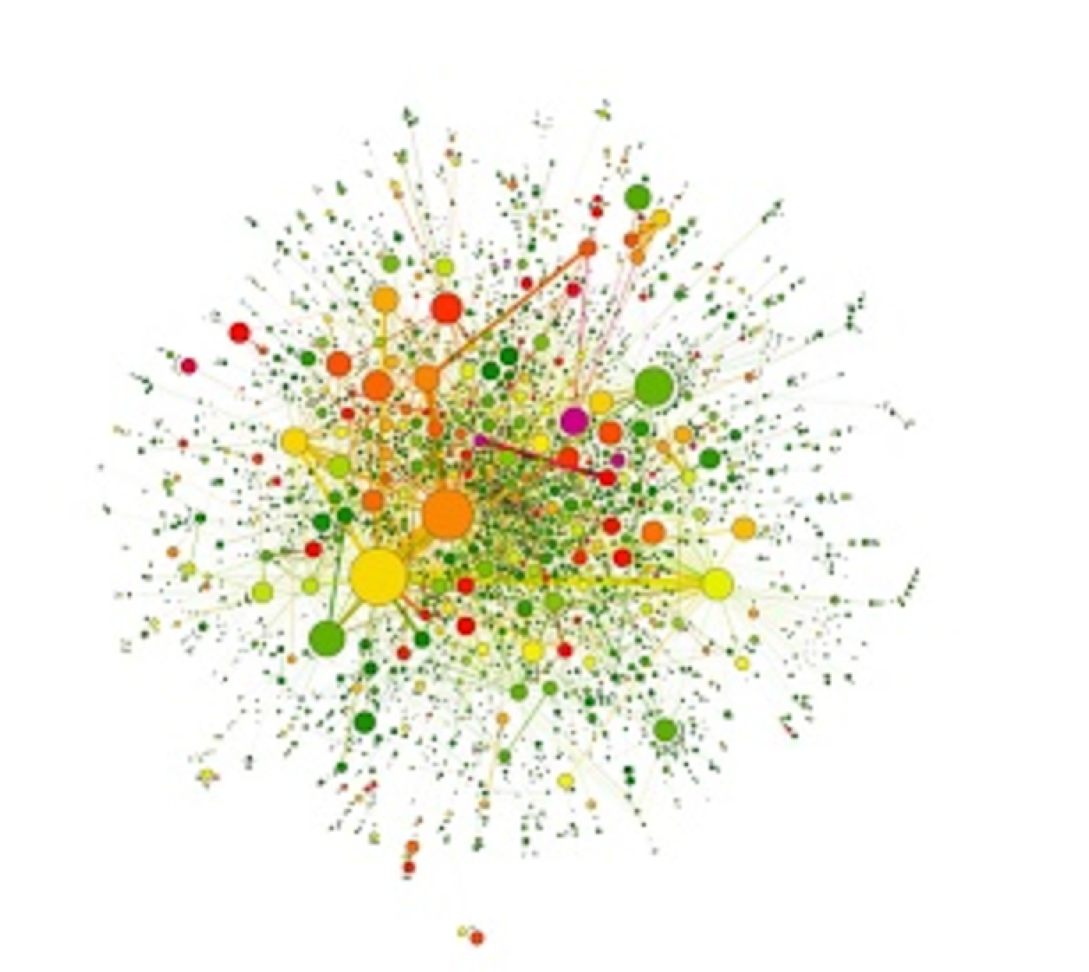
P(egs) bioinformatics for Postgrads
Postgraduate Evolution and Genomic Science Lecture series.

Slide 2
Intro to Network Analysis
Jo Watson
Francavilla lab
Schwartz lab
Phosphoproteomics
Cellular Signalling
Bioinformatics
Systems Biology
Notes:
I’m a PhD student using both lab and bioinformatics for my research. I look at how phosphorylation dynamics in cell signalling networks can act as molecular signatures for cellular behaviours, or are unique depending on the stimulant.
Because cellular signalling is basically one giant network, I use these kind of analyses a lot!

Slide 3
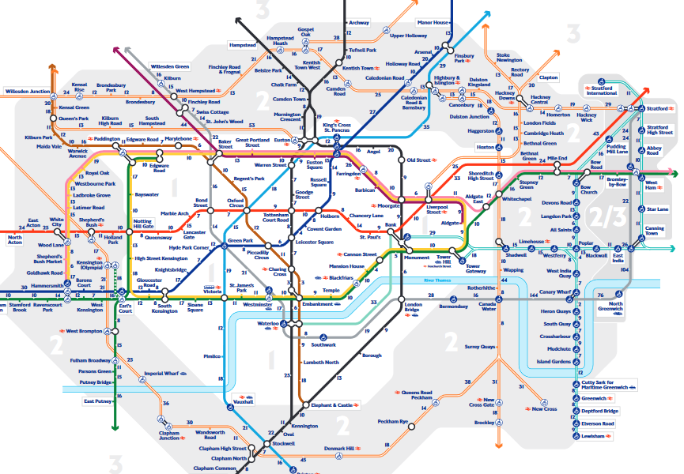
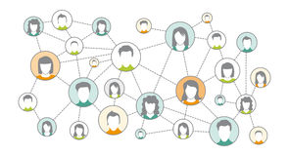
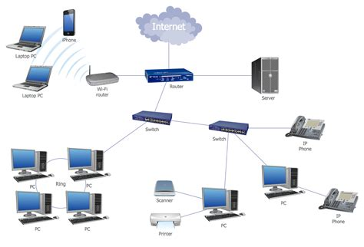
Networks are everywhere!
Notes:
Networks are data formats that describe relationships between objects or the flow of information.
In the real world, we are interacting with networks all the time, for example in transport… in our social circles… when we’re using IT systems or the internet…

Slide 4
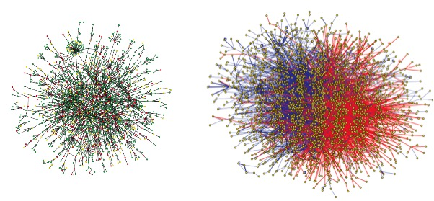
Representing Biological Systems as Networks
Yeast & human protein ‘interactome’
Jeong et al. Nature 2001. 411 & Rual et al. Nature 2005: 437
Notes:
But there are so many example of biological systems that are also behaving or can be understood as networks.
At the molecular level, we have protein or genetic interaction networks. For example, here we have the yeast protein interactome compared to the human protein interactome.
Networks that look like these are often called ‘hairballs’

Slide 5
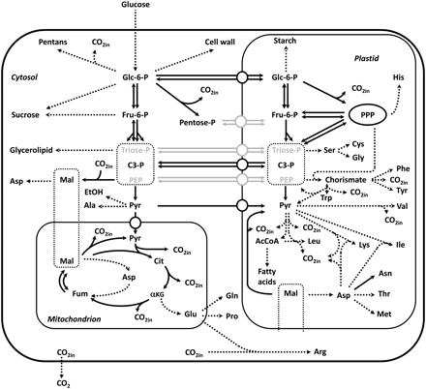
Representing Biological Systems as Networks
Glucose metabolism
Notes:
… Metabolic networks where biochemical reactions link various metabolites. E.g. glucose metabolism as shown here

Slide 6
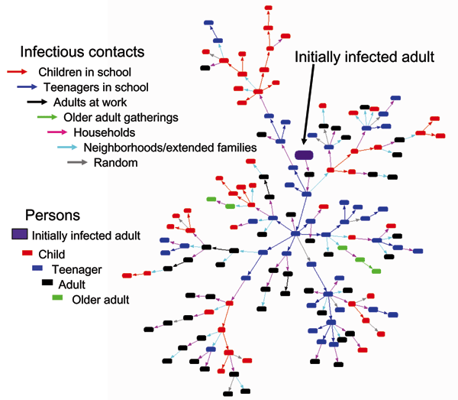
Representing Biological Systems as Networks
Model of disease spread in an influenza outbreak
Glass RJ, Glass LM, Beyeler WE, Min HJ. Targeted Social Distancing Designs for Pandemic Influenza. Emerg Infect Dis. 2006;12(11):1671-1681.
Notes:
On a macro level, networks are also used to work out disease spread amongst populations. In this study, the authors have mapped the spread of flu in an epidemic from patient zero, including where the disease spread happened and the person who spread it.

Slide 7
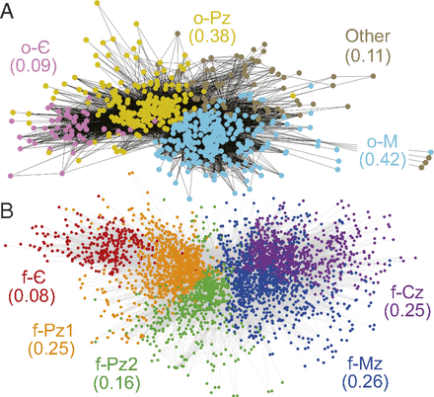
Representing Biological Systems as Networks
Quantifying ecological extinction using the fossil record
A. D. Muscente et al., PNAS 2018, 115 (20) 5217-5222
Notes:
And on an even bigger scale, they are also used in paleontology and archaeology.
In this example, nodes are taxa, and two taxa are linked if they co-occur at any fossil collection sampling point of Phanerozoic age
Other examples of ecological networks are food webs.

Slide 8
Intro to Network Analysis in Biology
1: How are networks constructed?
2: What can we use networks for?
3: Which tools can be used for network analysis?
Notes:
But those pretty figures aren’t just there to look impressive. They represent data structures that we can perform analyses. In this talk we are going to go through what networks actually are, what kind of analysis we can do with them to get interesting info out, and what tools are available to help us do this.

Slide 9
1: How are networks constructed?

Slide 10
Networks are composed of nodes and edges
F
B
A
E
H
C
G
D
Node (or vertex)
Edge (or link)
1: How are networks constructed?
Notes:
Networks are made up of nodes, which are the objects in our system, and edges, which describe the relationships or the connection between them
Nodes are sometimes called vertices and edges are sometimes called links, interactions, relationships…

Slide 11
Networks are mathematical graphs
 | A | B | C | D | E | F | G | H
A | 0 | 1 | 1 | 0 | 0 | 0 | 0 | 0
B | 1 | 0 | 1 | 0 | 1 | 0 | 0 | 0
C | 1 | 1 | 0 | 1 | 0 | 0 | 0 | 0
D | 0 | 0 | 1 | 0 | 1 | 0 | 0 | 0
E | 0 | 1 | 0 | 1 | 0 | 1 | 1 | 0
F | 0 | 0 | 0 | 0 | 1 | 0 | 0 | 1
G | 0 | 0 | 0 | 0 | 1 | 0 | 0 | 1
H | 0 | 0 | 0 | 0 | 0 | 1 | 1 | 0
B
F
A
E
H
=
C
G
D
Node E has a degree (k) of 4
1: How are networks constructed?
Notes:
But when we see a network like this, what we are actually looking at is a visualisation of a mathematical construct called a graph.
Graphs are often represented numerically in an adjacency matrix. In the matrix, each row and column corresponds to a node, and if there is an edge between two nodes there will be a 1 in the matrix.
We call the number of edges that are connected to a node the degree (k) of the node. So node E, for example, has a degree of 4 (k = 4), because it has edges with B, D, F and G.

Slide 12
Networks are mathematical graphs
Degree Distribution p(k)
B
F
A
E
H
C
G
D
2 3 4
Degree k
Node E is the most connected
Network N is scale-free
1: How are networks constructed?
Notes:
Each node will have a different degree (i.e. a different number of edges. We call this range the degree distribution p(k) and it tells us how the graph is arranged – it’s topology. So, for example, only one node has a degree of 4, but four nodes have a degree of 2, and 2 nodes have a degree of 3. This tells us that 1) node E is the most connected, and 2) the network is scale-free… few nodes will have lots of edges. This is true for all known graphs/networks in the real-world.

Slide 13
Networks can be directed or undirected
B
F
F
B
A
A
E
H
E
H
C
G
C
G
D
D
Molecular interactions, time- independent relationships
Signalling, Regulation, Evolution, Food webs, Metabolism
1: How are networks constructed?
Notes:
Edges can have specific properties that influence the graph. For example, they can be directed or unidirected (describing unidirectional, bidirectional or unknown direction of links)
Undirected : molecular interactions, such as protein complex formation
Directed : anything that represents time-dependent relationships – cellular signalling, regulation of processes, evolution, food webs….

Slide 14
Networks can be weighted or unweighted
B
F
F
B
A
A
E
H
E
H
C
G
C
G
D
D
Qualitative and descriptive data
Expression in ‘omics datasets,
Metabolic flux
1: How are networks constructed?

Slide 15
Attributes are used to describe nodes and edges
F
B
A
E
H
C
G
D
1: How are networks constructed?
Notes:
Aesthetics that are more often used for visualisation and than analysis
But they are useful – to describe effected tissues in a disease network, molecular subtype, different types of interaction…

Slide 16
2: What can we use networks for?
Uncovering the role a component or interaction has
Find functional units
Notes:
Two main reasons we do analysis on networks…

Slide 17
Shortest path (d) describes the distance between two nodes
B
F
F
B
A
A
E
H
E
H
C
G
C
G
D
D
d(C, F) = 3
d(C, F) isn’t equal to d(F, C)
d(C, H) = 4
2: What can we use networks for?
Notes:
If we want to know how distant a particular node is from another, or how well connected one group in the graph is, we can use a measure called shortest path.
This is all about working out how close or how related objects within the network are.
So for example, node C and node F have a shortest path of 3, whereas C and H have a shortest path of 4. So we can conclude that C / H are more distant. The meaning of this depends on the nature of your graph…
In directed networks, the shortest path has a slightly different meaning. As information flows only one way, the shortest path will be different depending on the direction.

Slide 18
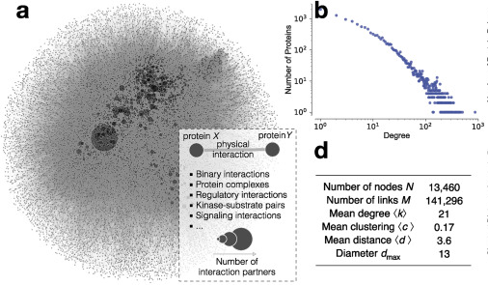
Shortest path (d) describes the distance between two nodes
In big networks the average shortest path is surprisingly small
Caldera et al. (2017) Current Opinion in Systems Biology, 3: 88-94
2: What can we use networks for?
Notes:
Kind of like the ‘six degrees of separation’ idea, big networks often have an average shortest path that is quite small.
In this study of the human proteein interactome, the authors constructed a big hairball network with >13,000 nodes and 140,000 edges. The mean distance was 3.6, and the longest ‘shortest path’ between any two nodes was 13.
In general we can conclude that a high average shortest path = weak connectivity / weak relationships between nodes.

Slide 19
Highly connected nodes are called hubs
Hubs have higher k than average.
B
F
A
E
H
C
G
D
Responsible for material/information flow
↓
Agents of disease spread
Removal of hub node destabilises network
↓
Classic therapeutic targets
Few hubs in network
↓
Increases network robustness
2: What can we use networks for?
Notes:
Part of the reason the avg shortest path can be so low is due to the presence of hub nodes.
Hubs have a higher k than average… in our example network, the hub is E, because (as we previously discussed), it has the highest degree.
Hubs have several functions that pertain to biological networks.
They are often the mediators of the flow of material / information. For example, if this was a social network, E would be more likely to spread an infection than A, because it has more connections.
2) If you remove the hub, the network is destabilised. In this case, there would be no connection between the left and right hand nodes. This makes hubs very common therapeutic targets.
3) On the other hand, having few hubs in the network increases robustness. If there is a perturbation to your network, it is more likely to happen to a node with few edges, and will be inconsequential to the network as a whole. Say this was a food web, and A, D or F are species of animals that disappear from a habitat , the network compensates with B, C, G, H or E.

Slide 20
Functionally related nodes organise into communities
Areas of dense connectivity
B
F
A
E
H
C
G
D
2: What can we use networks for?
Notes:
… also called modules, neighbourhoods, groups, clusters…
We cannot manually identify each group. Statisticians have designed algorithms that identify these groups for us, BUT each algorithm will have different parameters, so we might get different outcomes.
In this case D / E act as bridges between clusters.

Slide 21
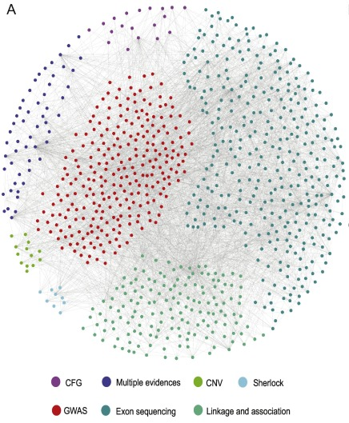
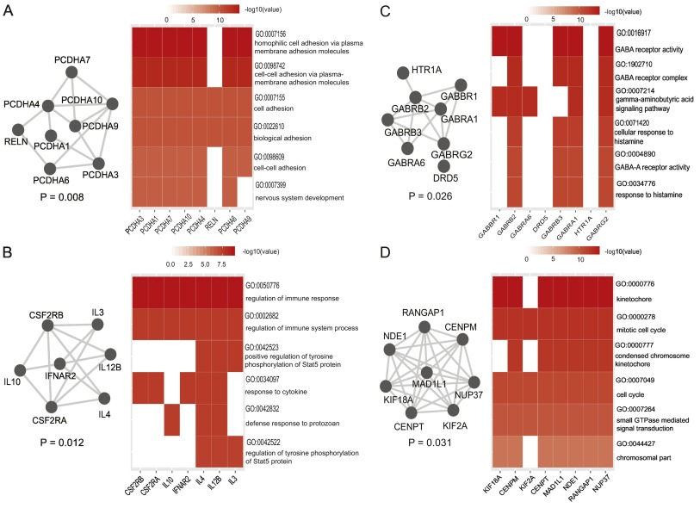
Functionally related nodes organise into communities
Liu et al. (2018), Schizophrenia Research, 201: 261-269
2: What can we use networks for?

Slide 22
3: Which tools can be used for network analysis?

Slide 23




Data for Network Construction
Graph Databases
‘Omics datasets
Literature curated
Individual observations from multiple experiments
Many of these have associated Cytoscape apps
3: Which tools can be used for network analysis?

Slide 24
Example data: Protein-protein interaction network in budding yeast
An edge table describes all the edges between nodes in the network
Node1 | Node2
YDR277C | YDL194W
YDR277C | YJR022W
YPR145W | YMR117C
YER054C | YBR045C
YER054C | YER133W
YBR045C | YOR178C
YBR045C | YIL045W
YBL079W | YDL088C
YLR345W | YLR321C
YGR136W | YGR058W
YDL023C | YJL159W
YBR170C | YGR048W
Attribute X
…
359 edges,
330 nodes
…
…
3: Which tools can be used for network analysis?

Slide 25
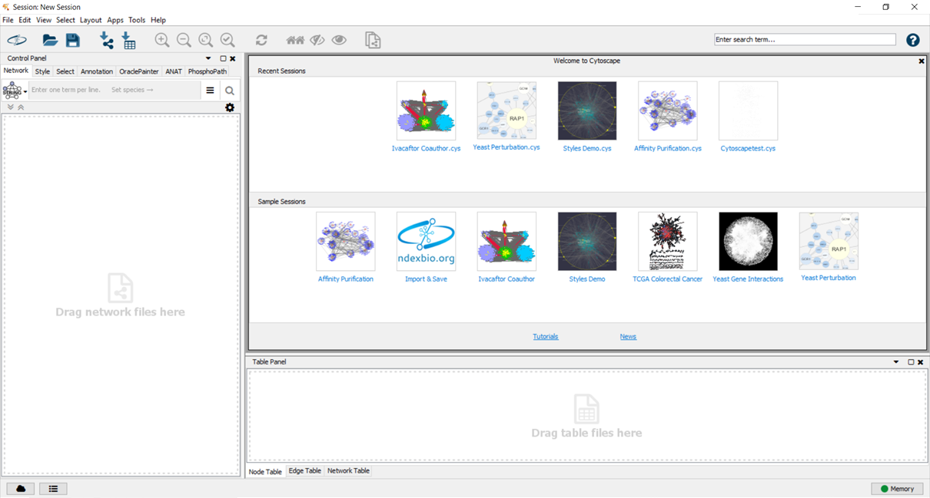

Cytoscape: the ‘no-coding’ option
‘Import network from file system’
Excel workbook, deliminated text (.txt, .csv),
Network file formats (GML, BioPAX, etc.)
3: Which tools can be used for network analysis?
Notes:
Importing network into cytoscape

Slide 26
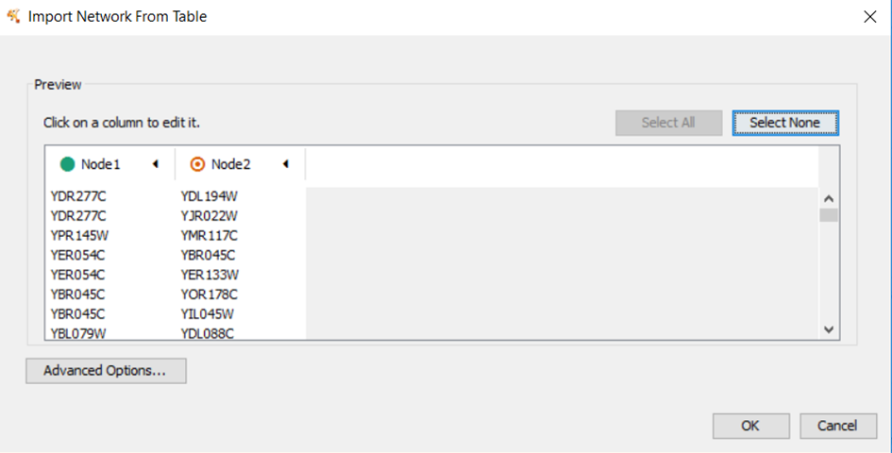
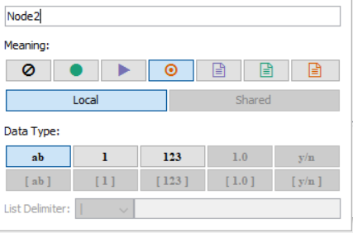
Cytoscape: the ‘no-coding’ option
3: Which tools can be used for network analysis?
Notes:
Importing network into cytoscape

Slide 27
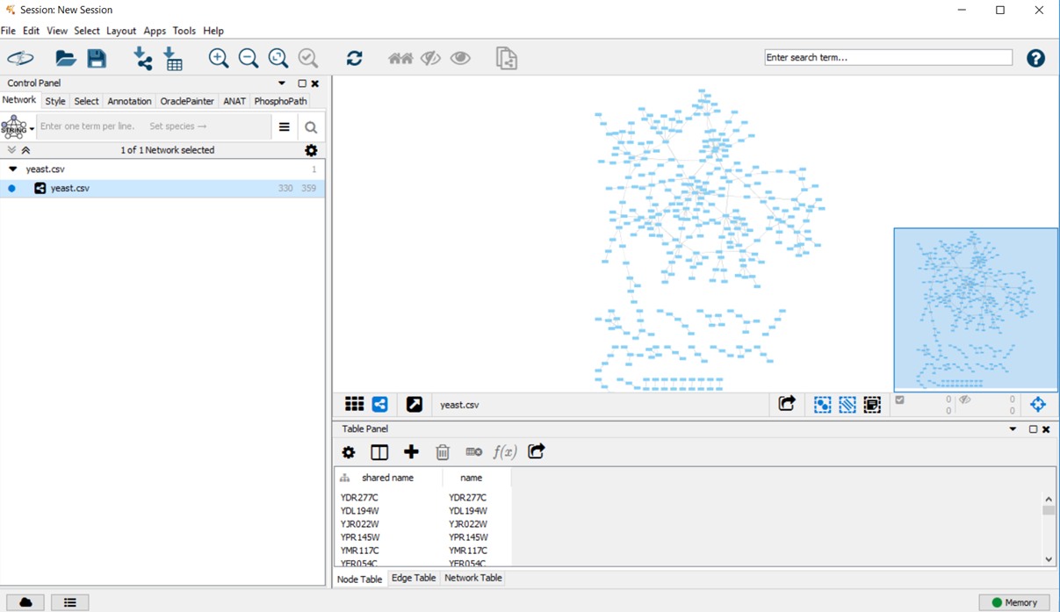
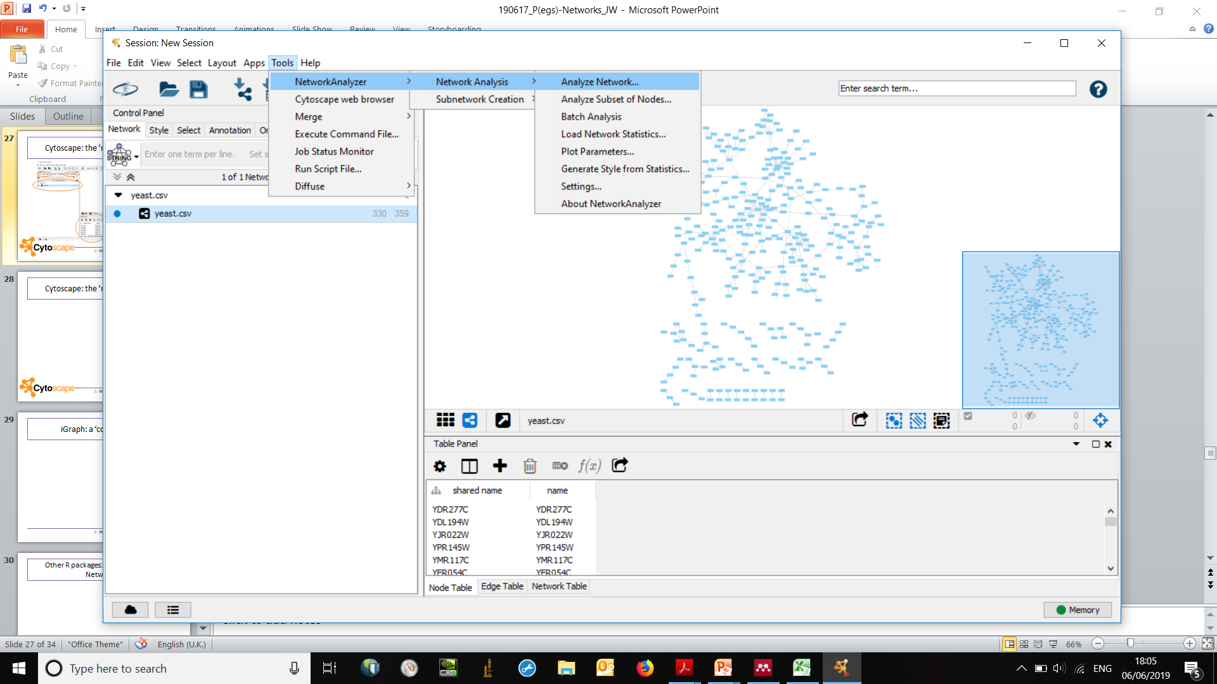
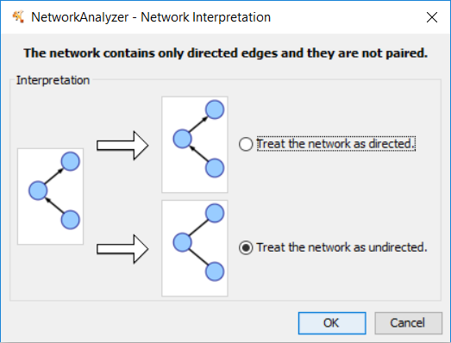
Cytoscape: the ‘no-coding’ option
Calculates:
Degree
Shortest path
Betweeness
Centrality
3: Which tools can be used for network analysis?
Notes:
Using the NetworkAnalzyer tool to calculate features of network

Slide 28
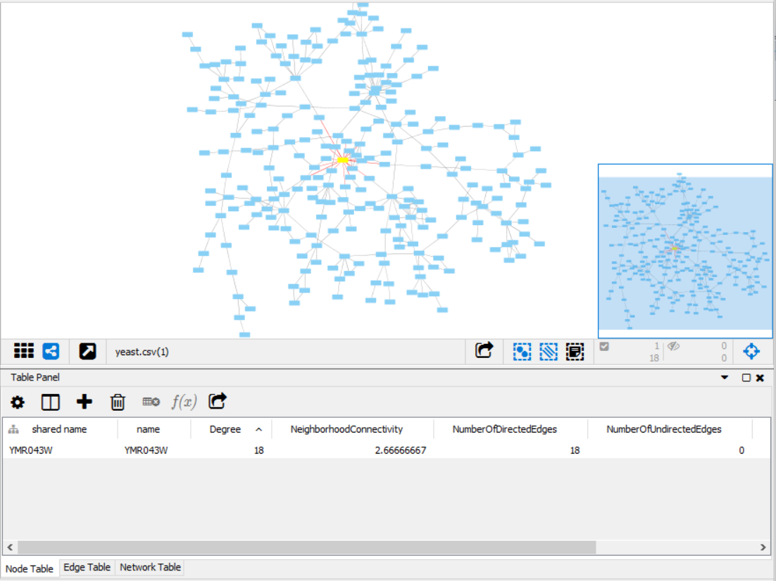
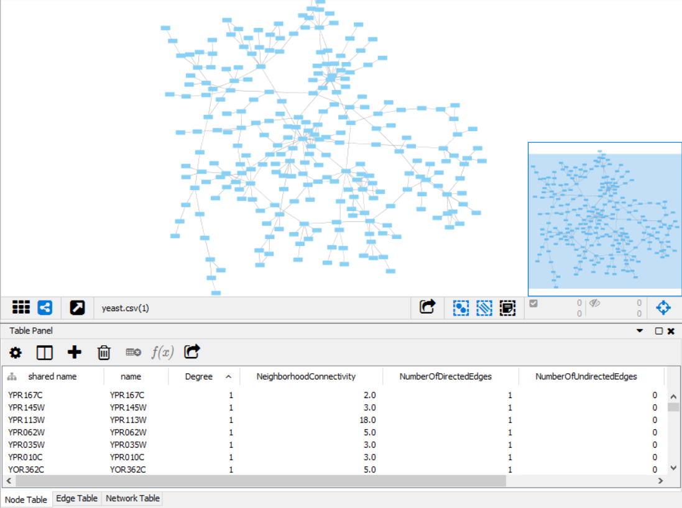
Cytoscape: the ‘no-coding’ option
Order node table by degree →
High degree = hub protein
3: Which tools can be used for network analysis?
Notes:
Following network analyzer

Slide 29
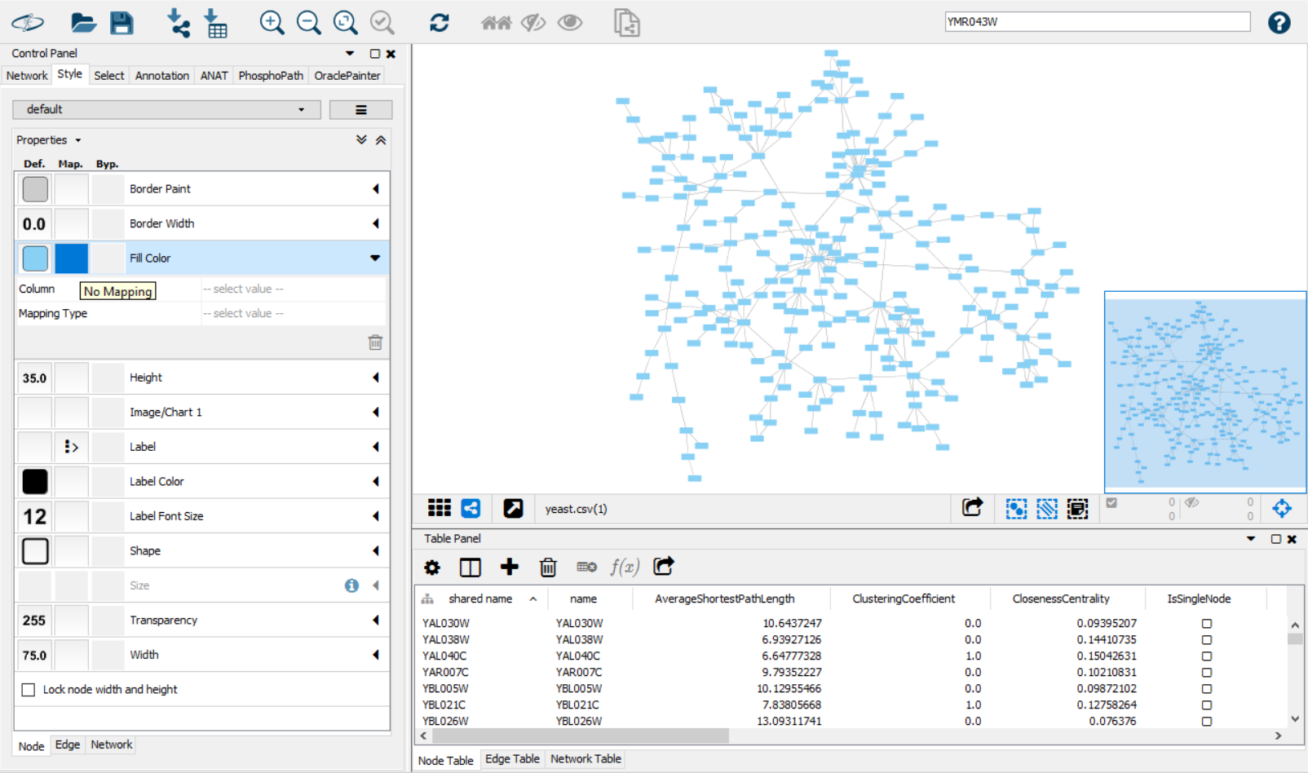
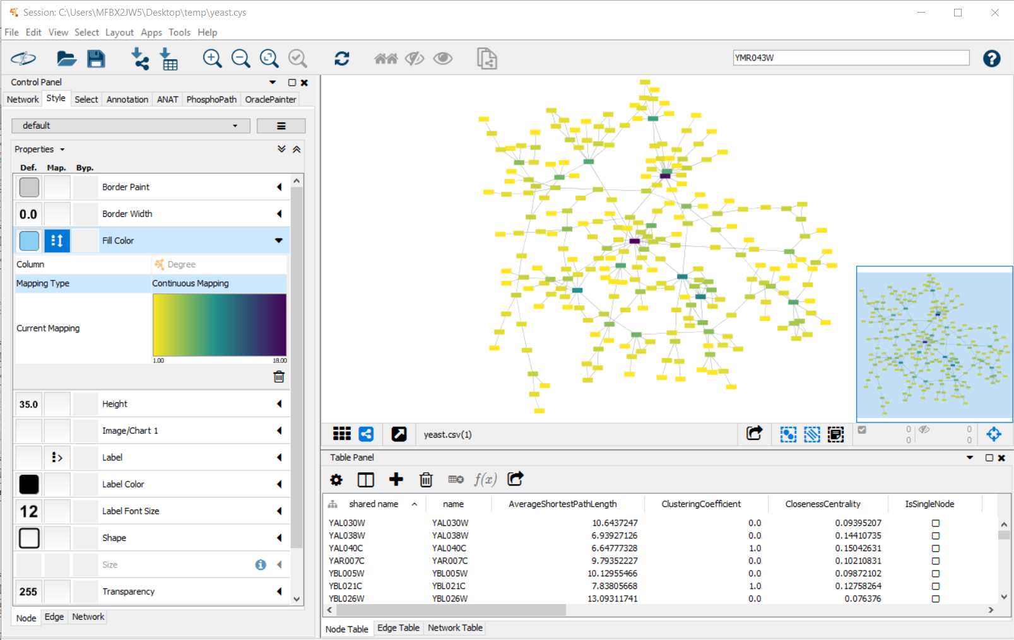
Cytoscape: the ‘no-coding’ option
3: Which tools can be used for network analysis?

Slide 30
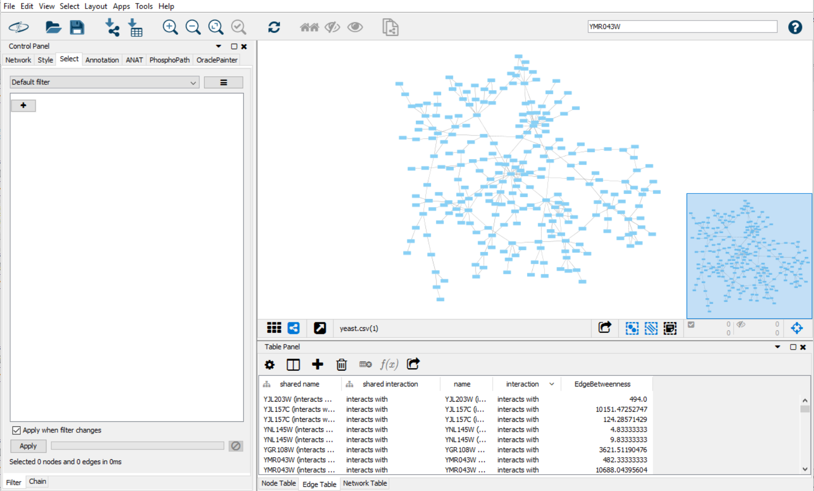
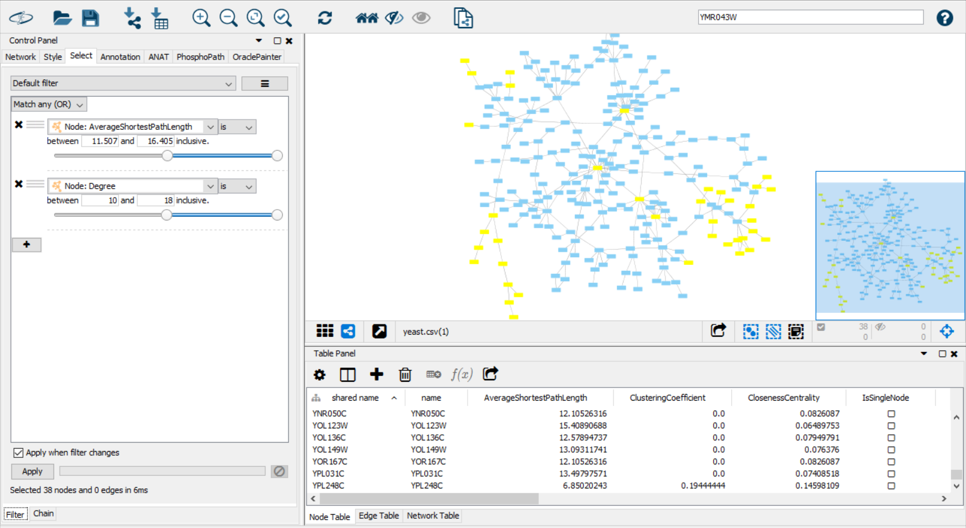
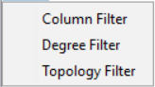
Cytoscape: the ‘no-coding’ option
3: Which tools can be used for network analysis?

Slide 31
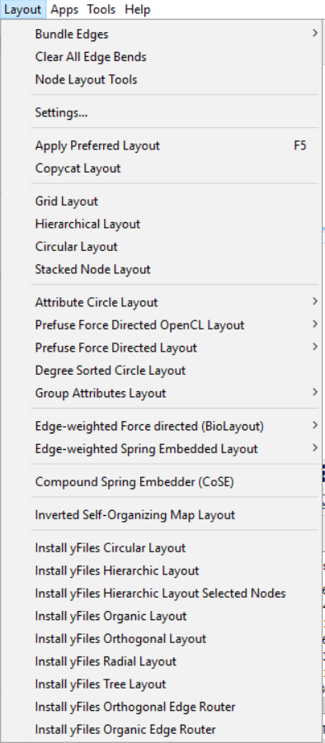
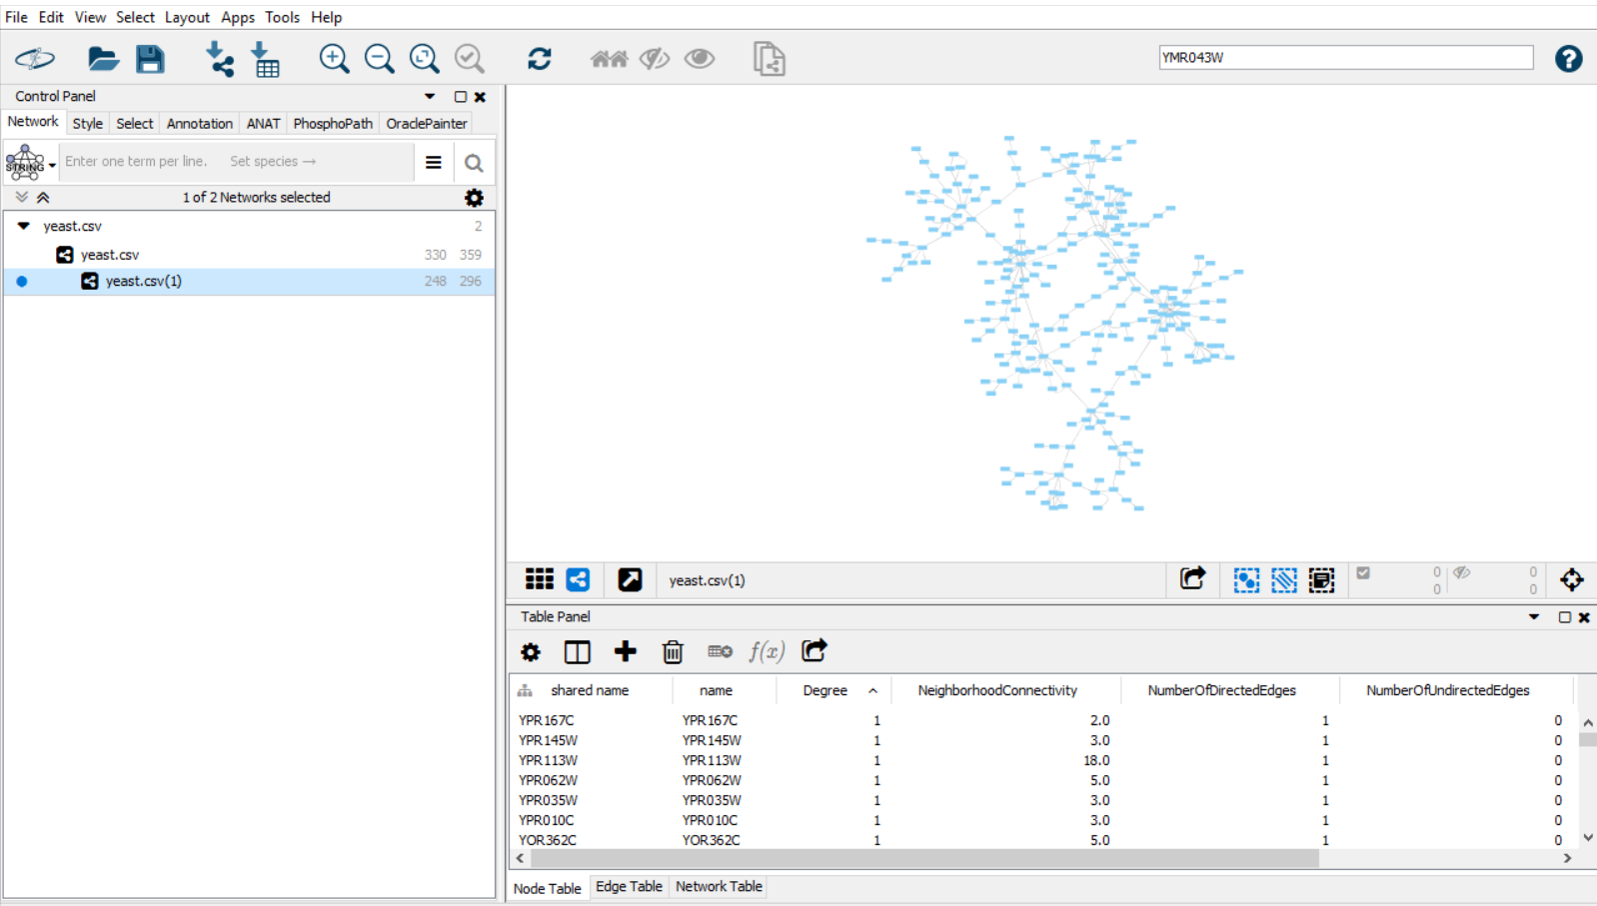
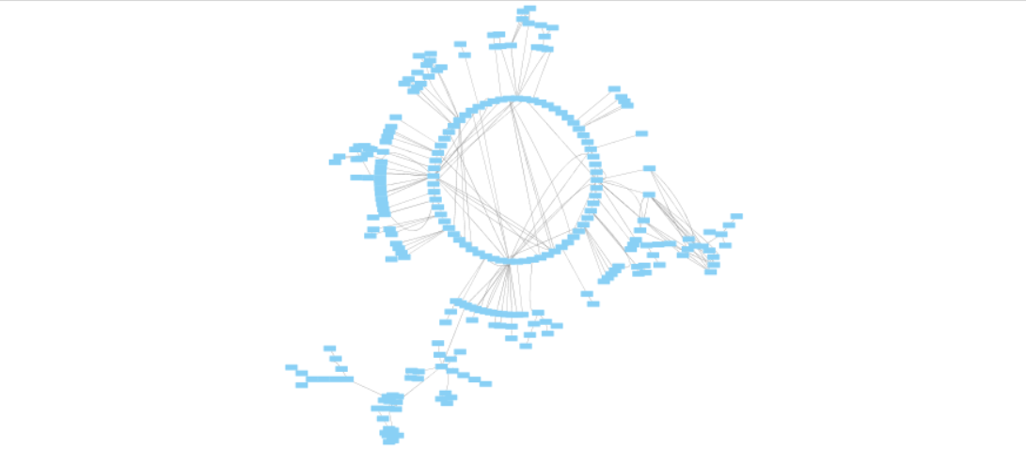
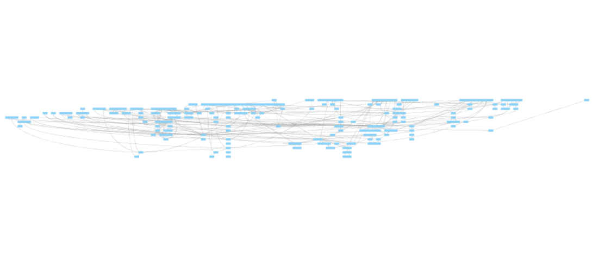
Cytoscape: the ‘no-coding’ option
3: Which tools can be used for network analysis?

Slide 32
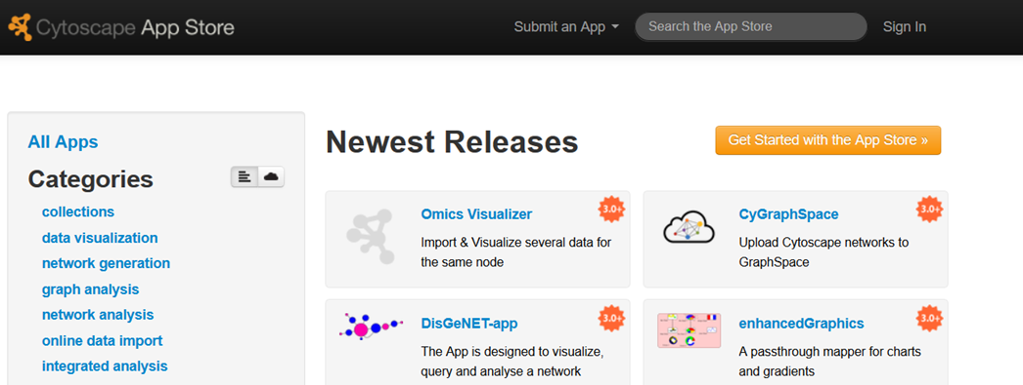
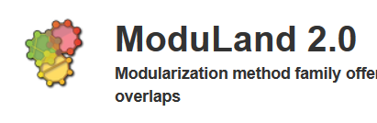
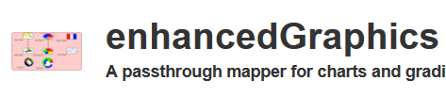
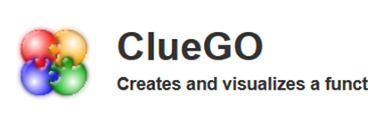

Cytoscape: the ‘no-coding’ option
http://apps.cytoscape.org/
3: Which tools can be used for network analysis?
Notes:
Add more functionality to cytoscape….
In particular, ModuLand 2.0 to find communities (and clueGO for molecular bio)
Enhancedgraphics to make fancier nodes

Slide 33


igraph: a coding option
3: Which tools can be used for network analysis?

Slide 34
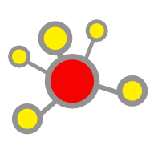
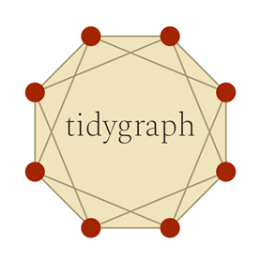
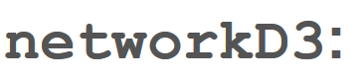
Other coding tools…
igraph
ggraph
NetworkX

Slide 35
Intro to Network Analysis in Biology
1: How are networks constructed? Nodes & edges, properties, layouts
2: What can we use networks for?
Distance, topology, communities
3: Which tools can be used for network analysis?
Cytoscape, R, Python, graph databases

Slide 36
Further Resources
Cytoscape tutorials
Kateto.net NetSciX 2016 Tutorial (iGraph/R)
EBI Network Analysis online training
Barabasi & Oltvai (2004), Nature Reviews Genetics, 5: 101-113
Almaas, E. (2007), The Journal of experimental biology, 210(9): 1548-58
Csermely et al. (2012), Pharmacology and Therapeutics, 138(3): 333:408

Slide 37
Thank You!
We would like to say a big thank you to the Division of Evolution and Genomic Science for supporting this series, and all of you for attending!
Please join us for drinks and chat in the café!

